Slide 1
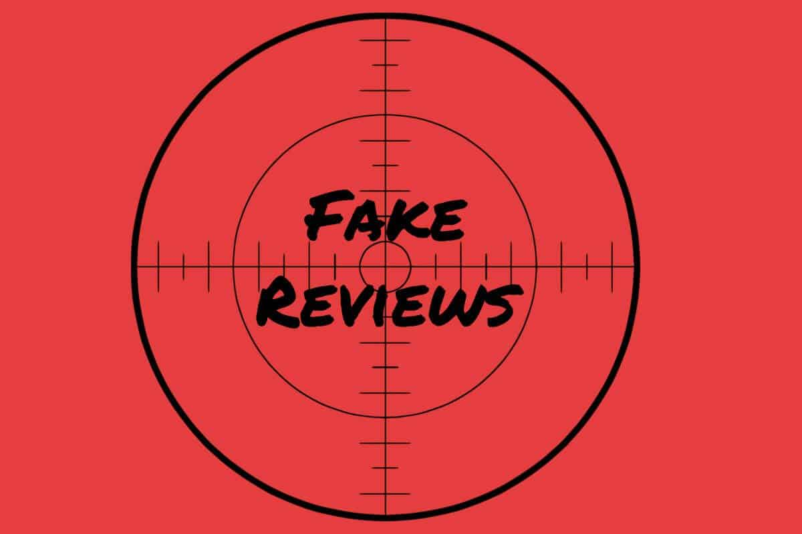
Fake Review Detection System
- Human Behaviour Based Approach

Slide 2
NEED FOR THE PROJECT
Online reviews play an important factor in helping customers know about the product or services. It helps
Customers in Decision making about purchasing of product/service
Service providers in making their services better
Reliance on online reviews gives rise to the potential concern that wrongdoers may create false reviews to artificially promote or devalue products and services. They must be detected in order to ensure that the social media continues to be a trusted source of public opinions, rather than being full of fake opinions, lies, and deceptions.

Slide 3
Types of Spam Reviews
Fake or Untruthful Reviews
These are untruthful reviews that are written not based on the reviewers’ genuine experiences of using the products or services, but are written with hidden motives.
They often contain undeserving positive opinions about some target entities (products or services) in order to promote the entities and/or unjust or false negative opinions about some other entities in order to damage their reputations.

Slide 4
Types of Spam Reviews
Reviews about brands
These reviews do not comment on the specific products or services that they are supposed to review, but only comment on the brands or the manufacturers of the products.
Although they may be genuine, they are considered as spam as they are not targeted at the specific products and are often biased.
For example, a review for a specific PNG product says “I hate PNG, I never buy any of their products”.

Slide 5
Types of Spam Reviews
Non-Reviews
These are not reviews as they do not provide any information about the product or service. They contain the irrelevant data.
There are main two sub-types:
Advertisements
Other irrelevant texts containing no opinions (e.g., questions, answers, and random texts)

Slide 6
WORKFLOW
Fake Review Detection system is carried out in two stages:
1) Generating Sentiment
This stage involves training a sentiment analyzer for the Hotel reviews so that the analyzer could predict the sentiment of the review to be tested and could generate the rating for the review on the scale from 1 to 5.

Slide 7
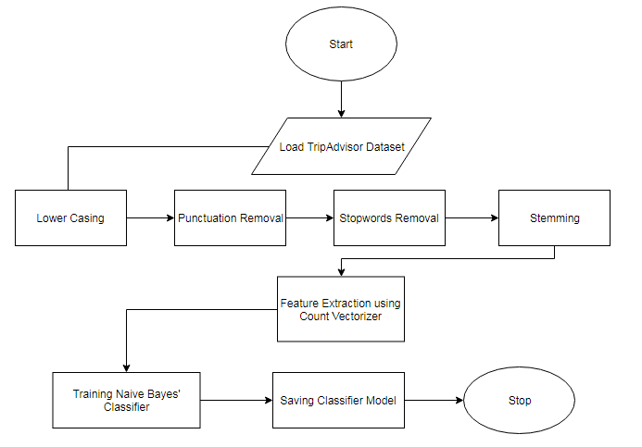
Flowchart for Sentiment Analyzer

Slide 8
WORKFLOW
Fake Review Detection system is carried out in two stages:
2) Spam Review Detection
The Sentiment Analyser generated in previous step is used in extraction of features for the opinion spam model. There are various statistical as well as behavioural features that are fed into our Machine Learning classifier to label the review as Deceptive or Truthful

Slide 9
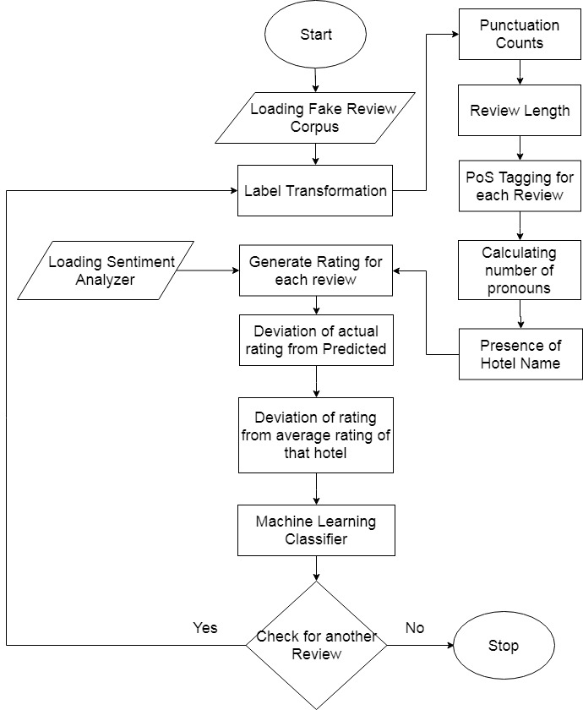
Flowchart for Fake Review Detection

Slide 10
RESULTS
Many classifiers have been used with the combination of our extracted features to correctly predict the genuineness of the review. We trained our training Data using various classifiers such as Naïve Bayes’ classifier, Logistic Regression and Linear Support Vector Machine.
Among all the above classifiers used, Logistic regression provided with the best accuracy of 69.75% followed by the Linear SVC which attained the accuracy of 69%.

Slide 11
THANK YOU!

